Slide 1
Annual General Meeting 2025 15 October 2025 Professor Tim Briggs, interim chair of Moorfields
RECORDING IN PROGRESS
Notes:
LED BY TIM

Slide 2
House rules – Annual General Meeting
This meeting is being streamed and will be posted online for those who could not attend.
Please try and keep noise to a minimum as it may be heard for those online to hear what is being said and please keep your phones on silent.
If you are online and don’t want to be seen please leave your camera off.
We are not expecting a fire alarm drill so if the alarm goes off, please follow guidance from our staff
After the main presentations, there will be a chance for you to ask questions.
Before these are opened to the audience in the room, we will be answering those submitted in advance of the AGM.
If you are asking a question, you will be asked your name and if you are a patient, staff member or stakeholder.
Notes:
Welcome to Moorfields Eye Hospital Annual General Meeting.
My name is Professor Tim Briggs and I am the interim chair of Moorfields.
I became interim chair in April and I am delighted to be chairing my first AGM at Moorfields.
We are joined by our board, as well as the membership council, including Lead Governor Rob Jones and Deputy Chair Allan MacCarthy; and a number of staff and members of the trust are present with us today.
I would like to extend a warm welcome to everyone who is here today, including staff and members, your presence is very much appreciated.
Before we start, I would like to run through some house rules – read out the slide

Slide 3
AGM agenda
3.30pm: Welcome from the chair of the board of directors Professor Tim Briggs
3.40pm: Review of governor activity from the vice-chairman of the membership council Allan MacCarthy
3.50pm: Interim chief executive Peter Ridley and chief financial officer Arthur Vaughan’s review of the year
4.05pm: Chief nurse Sheila Adam’s quality and safety, education and Friends of Moorfields review
4.10pm: Questions
4.20pm: Chair’s closing remarks
Notes:
This afternoon, we will be hearing a review of governor activity during the year from vice chair of our membership council, Allan MacCarthy.
This will be followed by highlights from the year and a performance review from Peter Ridley, our interim chief executive, a financial and operational review from Arthur Vaughan, chief financial officer and a review of our quality and safety and education performance by Sheila Adam our chief nurse.
There will then be an opportunity to ask questions. We also asked for questions to be submitted in advance, particularly to enable those who are watching online to submit questions. We’ll answer these questions as well as those raised in the hall. When you ask a question, it would be helpful if you could give your name and explain in what capacity you are here today – member of Moorfields, patient, staff etc. When we have finished answering questions, this will conclude the formal part of the meeting.
So, to start proceedings, we need to approve the minutes from last year, which have been posted on the website. I am aware that Rob Jones is proposing we accept the minutes of the AGM from last year, and Paul Murphy is seconding these (note: they are joining online but do not need to say anything). Can we approve the minutes - approved.
I would now like to draw your attention to two important records of the year that has just been – our 2024/25 annual report and our accompanying quality report. They are on our website, and they are really important accounts both of what we have achieved and how we have done it. If you’ve not read them, please do as they give a real flavour of the extraordinary range of clinical care that we offer, and of how the whole organisation is focused on delivering safe and effective care.

Slide 4
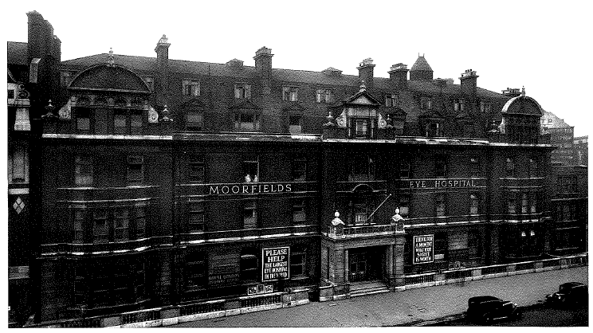
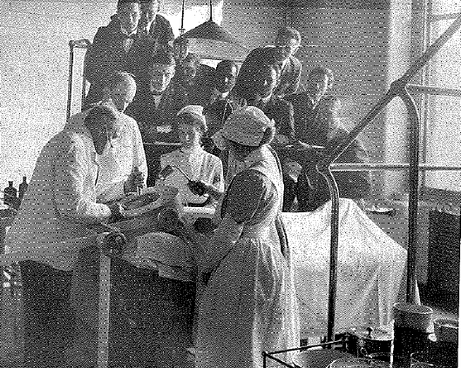
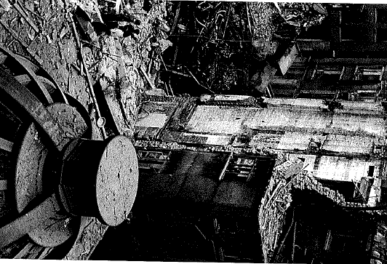

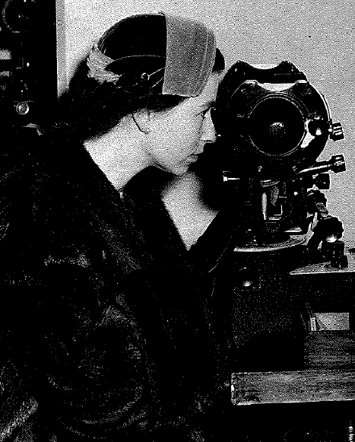

History of Moorfields
Notes:
Moorfields has a proud history of delivering exceptional ophthalmic treatment and care as you can see from these brilliant photographs on this slide.
Our rich history is important to us and delivering the best care and treatment is still our top priority now.
I am pleased to give an overview of the past year to showcase our achievements as a trust and I’m delighted the hard work of everyone at Moorfields was recently recognised when the trust was rated highest in the country for acute NHS trusts in a new national league table. A fantastic achievement!
I would like to reflect that there have also been some leadership changes at Moorfields over the past year. Change can sometimes be challenging so I’d like to thank everyone who has contributed to ensuring the organisation’s ongoing stability during this time of change.
Over the last six months in my role as interim chair what has really struck me about Moorfields is how fantastic and innovative our staff are who go above and beyond on a daily basis for our patients, and I have very much enjoyed meeting so many since I began this role. I had the great pleasure of attending my first Moorfields Stars event in September which is our flagship awards celebrating the fantastic work of our people. It was a privilege to meet so many of our stars and to be part of an event that celebrates the work our staff do as they go above and beyond on a daily basis.
This AGM is going to highlight some of the great achievements accomplished here over the year and for me, these are the achievements of all our staff. Without them none of this would be possible.
Highlights include progress being made key transformation projects including MoorConnect, our new electronic patient record system, and our new centre for advancing eye care currently known as Oriel. You’ll also hear updates on how we are ensuring Moorfields is an equitable and inclusive place to work – all part of our commitment to learning and evolving as an organisation.
Every member of staff plays a vital part in the success of this hospital and in the exceptional care we provide for our patients.
On behalf of the Board, I would like to thank everyone for their dedication and hard work. Together we are Moorfields.
Now I would like to hand over to Allan MaCarthy for the review of Governors’ activity.

Slide 5
Annual General Meeting 2025 15 October 2024 Allan MacCarthy, vice-chair of Moorfields council of governors
Notes:
Thank you, Tim

Slide 6
Our governors
John Sloper, Bed & Herts
Paul Murphy, NCL
John Russell, NEL & Essex
Vijay Arora, NWL
Robert Goldstein, NCL
Robert Jones, Patient
Emily Brothers, Patient
Allan MacCarthy, SEL
Kimberley Jackson, SWL
Dinesh Solanki, NWL
Emmanuel Zurdis, SWL
Yasir Khan, Staff
Sean Cooke, NEL & Essex
Margaret Connor, Beds and Herts
Suryanarayana (Naga) Subramanian, SEL
Ursula Smartt, Patient
Yasir Khan, Staff
Amit Arora, Staff
John Shubhaker, Staff
Folesade Bakare, Staff
Tricia Smikle, RNIB
Ian Humphreys, The College of Optometrists
Santiago Bell-Bradford, LB of Islington
Notes:
Allan to read out his summary of governors' activity and thank the governors for their hard work.
When Allan finishes summary to say: And now I would like to hand over to Peter Ridley, interim chief executive, to talk us through the highlights of 2024-25
HANDOVER TO PETER

Slide 7
Annual General Meeting 15 October 2025 Review of 2024/5 Peter Ridley, interim chief executive
Notes:
Thanks Allan, I’m Peter Ridley, interim chief executive of Moorfields Eye Hospital.
I would also like to welcome you all here. I will talk through the highlights of the year, our chief financial officer, Arthur Vaughan, will cover our financial performance and Sheila Adam our chief nurse will cover quality and safety and education performance.

Slide 8
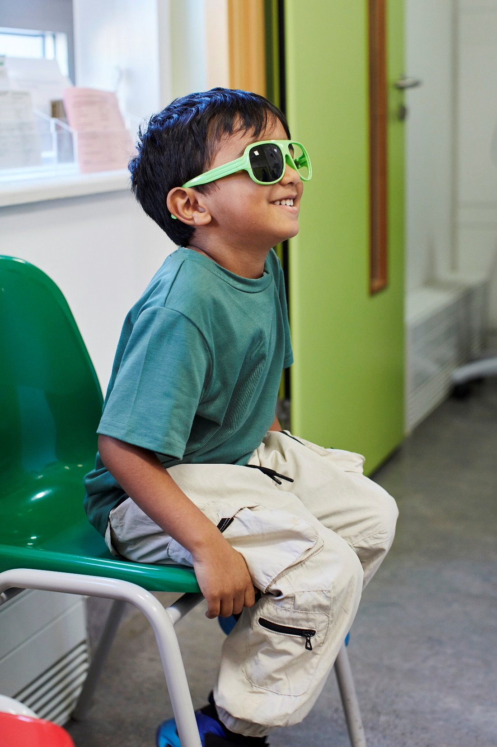
Why Moorfields matters
People’s sight matters
People are suffering avoidable sight loss
We have more people trying to prevent this than anyone else
Increasing burden of disease
Biggest outpatient specialty
Notes:
To start this presentation, I would like to remind you why what we do here at Moorfields is important
People’s sight matters – after cancer, sight loss is the most feared medical condition
Across the country and in London, people still suffer avoidable sight loss
We have more people trying to prevent sight loss than anyone else, so we have a duty to share our learning and research as widely as possible
In England, and actually worldwide, health services generally are struggling with an ageing and more diabetic population. This particularly impacts ophthalmology, which is already the biggest outpatient speciality

Slide 9
What Moorfields does
Working together to discover, develop and deliver excellent eyecare, sustainably and at scale
Excellence, equity and kindness are our values
Notes:
Our purpose is working together to discover, develop and deliver excellent eyecare, sustainably and at scale and our values are excellence, equity and kindness.
Moorfields has long been recognised as a global centre of excellence for eye care, research and education. We also need to be equally excellent as a place to work.
It’s not just what we do that’s important – how we do it is just as important to our patient experience, and to how our staff feel at work
That’s why our two other values are so important – treating everyone equitably, and showing kindness to both patients and colleagues.

Slide 10
Three important things we have done this year
Topping out – our new centre in Camden reached its maximum height in December 2024.
Signed the contract for our new electronic patient record, and launched the programme to deliver it
Developed, launched and embedded a Single Point of Access for ophthalmology referrals in North Central London
Notes:
Before we go through all the slides, I want to tell you the three things I think are particularly important for our future.
During 2024/25, we have:
Our new centre in Camden reached is maximum height in December 2024, known as topping out
We signed the contract for our new electronic patient record, and started work on it
We developed, launched and embedded a Single Point of Access for ophthalmology referrals in North Central London

Slide 11
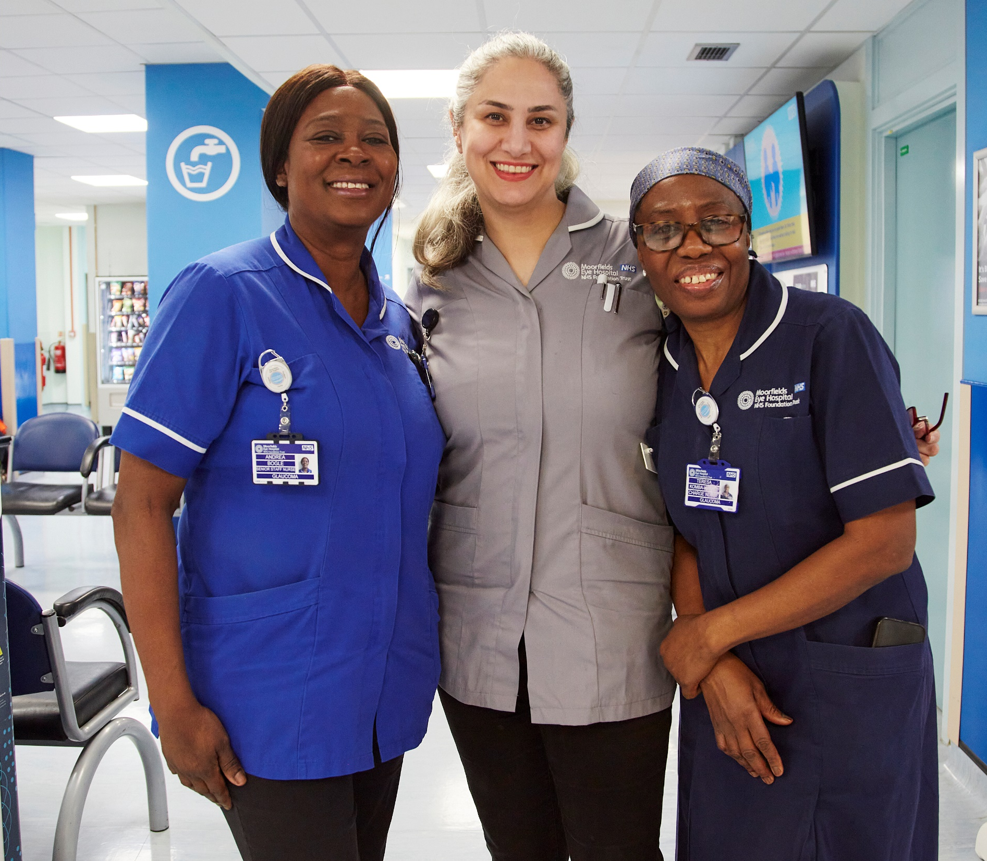
Working together
Notes:
This review is structured around our purpose, and begins with ‘Working together’.
We are in a period of great change, within the NHS, as a nation and globally, with a new government and a new 10 year plan for the NHS.
We cannot achieve excellence alone. We work in partnership with a wide range of organisations. These include UCL Institute of Ophthalmology, the National Institute of Health and care Research, NHS partners including NHS England and North Central London Integrated Care Board, councils, the voluntary sector and, closer to home, Moorfields Eye Charity and Friends of Moorfields and, of course, our staff and teams.
Every individual contributes to Moorfields fulfilling its purpose, whether this is developing groundbreaking new treatments, delivering consistently high standards of patient care or supporting the systems and processes that help Moorfields to work efficiently and at pace.

Slide 12
Equality, diversity and inclusion (EDI) progress
Emerging evidence* suggests the EDI programme has established a strong foundation for fostering a more inclusive and equitable organisational culture.
Key interventions reflect a shift from historically ad hoc approaches to EDI toward the intentional embedding of a foundational infrastructure that enables equity and inclusion.
Examples include:
The implementation of the NHSE Equality Delivery System
Introduction of the Share not Declare campaign
Our redesigned Equality and Health Impact Assessment (EHIA) process
In addition, improvements across key WRES and WDES metrics and insight from a robust audit of recruitment practices indicate growing organisational maturity of EDI.
*Source 24/25 WRES and WDES data
Notes:
Emerging evidence suggests the EDI programme has established a strong foundation for fostering a more inclusive and equitable organisational culture.
Key interventions reflect a shift from historically ad hoc approaches to EDI toward the intentional embedding of a foundational infrastructure that enables equity and inclusion.
Examples include:
The implementation of the NHS England Equality Delivery System
Introduction of the Share not Declare campaign
Our redesigned Equality and Health Impact Assessment (EHIA) process
In addition, improvements across key WRES and WDES metrics and insight from a robust audit of recruitment practices indicate growing organisational maturity of EDI.

Slide 13
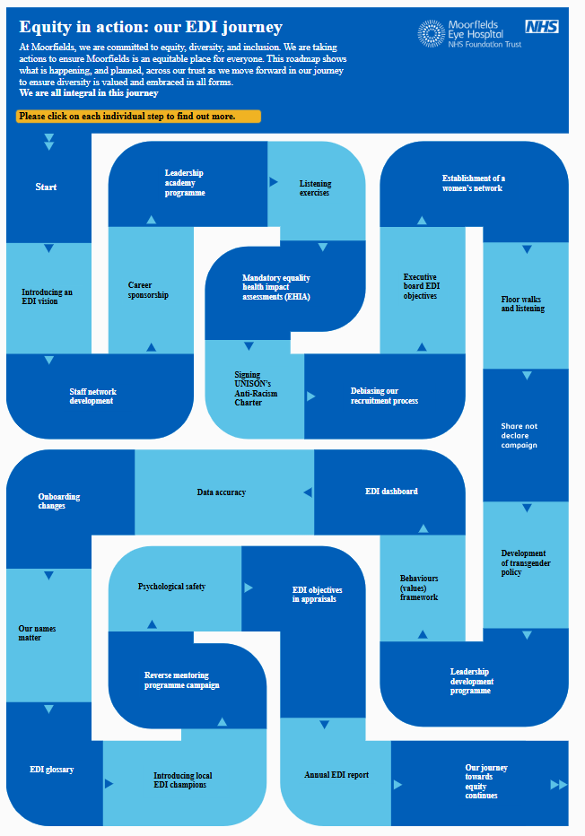
Equality, diversity and inclusion (EDI) progress
Moorfields EDI roadmap
We have introduced a Moorfields EDI roadmap, documenting our EDI journey – showing what is happening, and planned, across our trust in a clear and transparent way – as we move forward in our journey to ensure diversity is valued and embraced in all forms. This includes regularly updating 20+ individual projects, each with different communication strands.
UNISON Anti-Racism Charter
We took significant steps toward becoming an anti-racist organisation by signing the UNISON Anti-Racism Charter. The supporting delivery programme is mapped to our EDI programme. We are now on a journey to embed anti-racism into our leadership and training programs, improving understanding of race related issues.
Notes:
We have introduced a Moorfields EDI roadmap, documenting our journey – showing what is happening, and planned, across our trust in a clear and transparent way – as we move forward in our journey to ensure diversity is valued and embraced in all forms. This includes regularly updating 20+ individual projects, each with different communication strands.
We took significant steps toward becoming an anti-racist organisation by signing the UNISON Anti-Racism Charter. The supporting delivery programme is mapped to our EDI programme. We are now on a journey to embed anti-racism into our leadership and training programs, improving understanding of race related issues.

Slide 14
Equality, diversity and inclusion (EDI) progress
Progress toward greater disability inclusion
We can see an emerging reduction in the percentage of staff experiencing discrimination due to disability.
Notes:
There is an emerging reduction in the percentage of staff experiencing discrimination due to disability, showing we are making progress in increasing inclusion for disabled people.

Slide 15
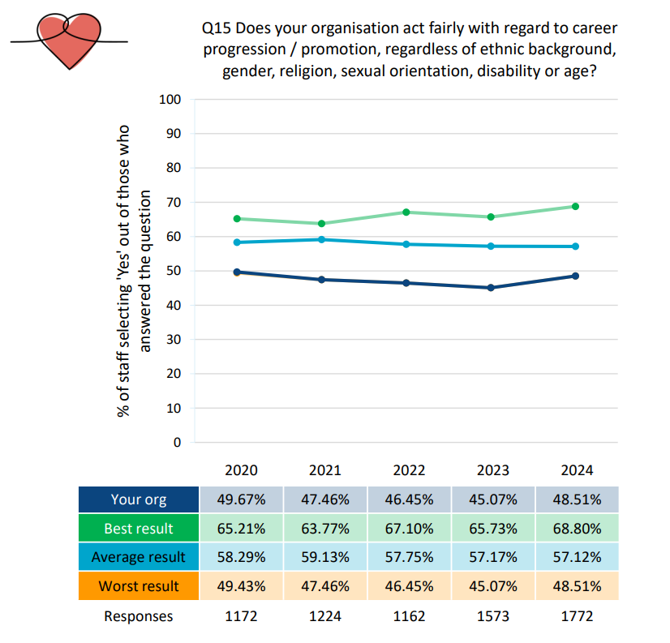
Equality, diversity and inclusion (EDI) progress
Career progression
Staff perceptions of fairness regarding career progression at Moorfields is improving. Partly reflecting the early impact or recognition of targeted EDI initiatives such as the Career Sponsorship programme and the Leadership Academy Programme.
Notes:
We are also seeing improvements in staff perceptions of fairness regarding career progression at Moorfields.
This partly reflects the early impact or recognition of targeted EDI initiatives such as the Career Sponsorship programme and the Leadership Academy Programme.

Slide 16
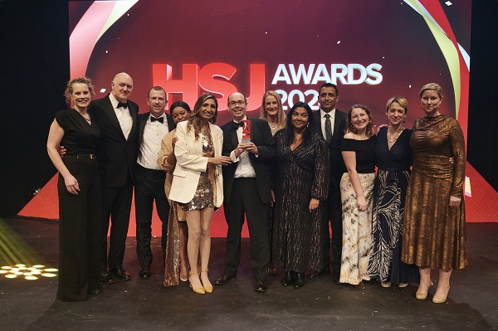
Single Point of Access (SPoA)
During this year, we have seen the benefits of the North Central London (NCL) SPoA, which processed over 29,000 referrals
It benefits patients as well as improving efficiency for eye care providers
It won a prestigious HSJ Award – Acute Sector Innovation of the Year
Notes:
During this year, we have seen the benefits of the North Central London single point of access programme, to improve the referrals coming into providers.
As a result of this, it won a prestigious HSJ Award, as the acute sector innovation of the year.
The partners working together with Moorfields are Royal Free London, North Central London (NCL) integrated care board, the Local Optical Committee Support Unit (LOCSU) and NHS England
Patients benefit from a choice of provider, considering factors important to them such as reputation, waiting times and location.
Through the Single Point of Access, better training of referrers has increased the quality of referrals, improving quality and efficiency.
The result of all of this is that patients are seen quicker.

Slide 17
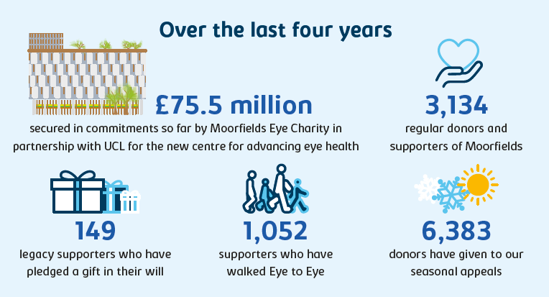
Moorfields Eye Charity’s donors
Notes:
In partnership with UCL, Moorfields Eye Charity has raised over £75 million towards our new centre for advancing eye health. Without philanthropy, this simply would not have been possible.
The charity is proud of the community of dedicated supporters and donors who regularly give their time, support and donations to Moorfields.

Slide 18
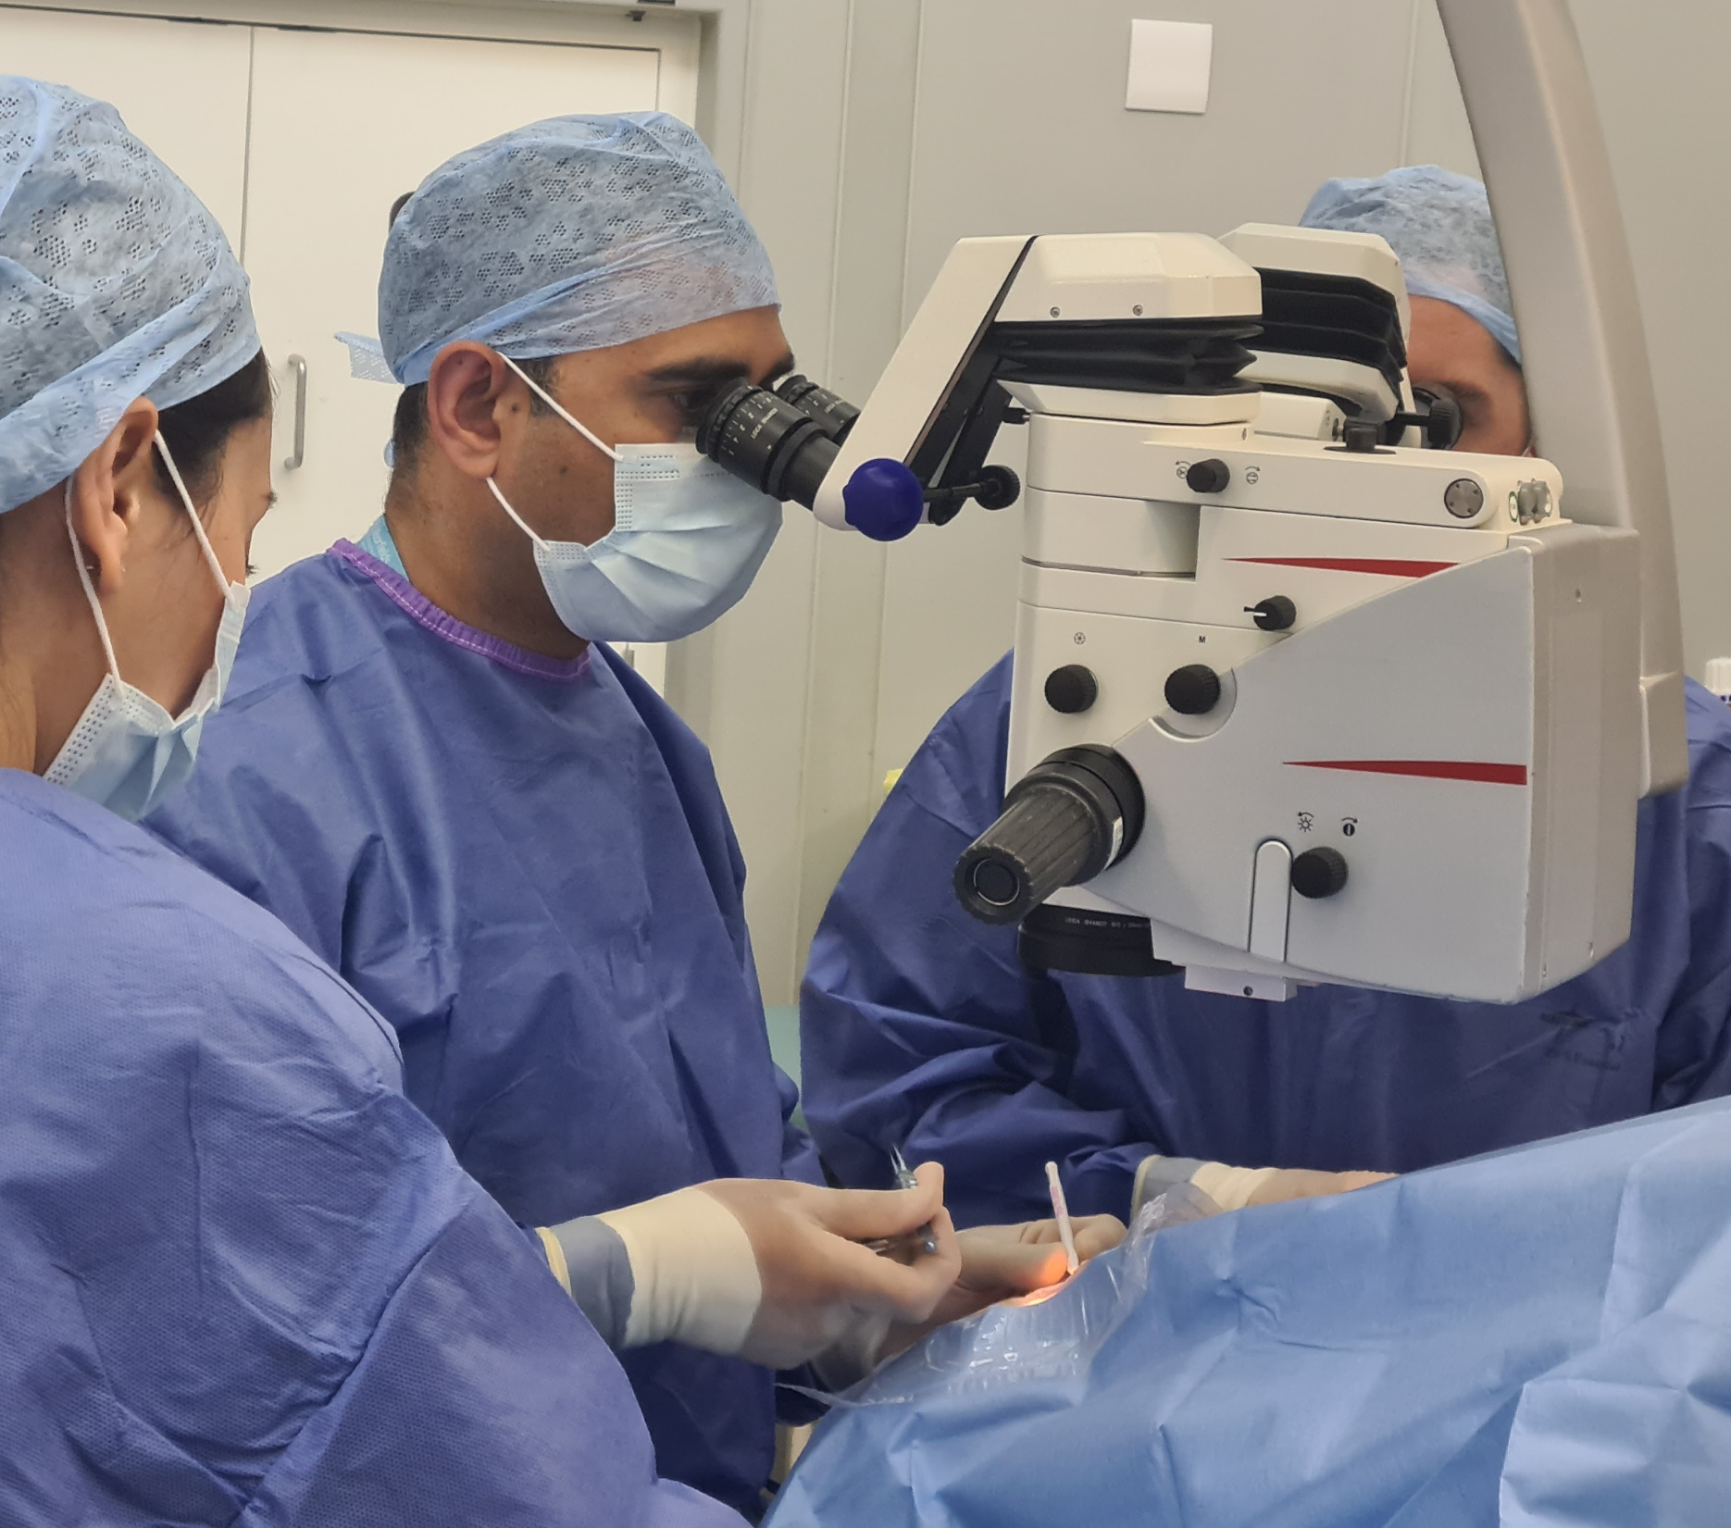
Discover
Notes:
Discovery is at the heart of what we are as an organisation, and 2024/25 was no exception. We made several breakthroughs during the year.

Slide 19
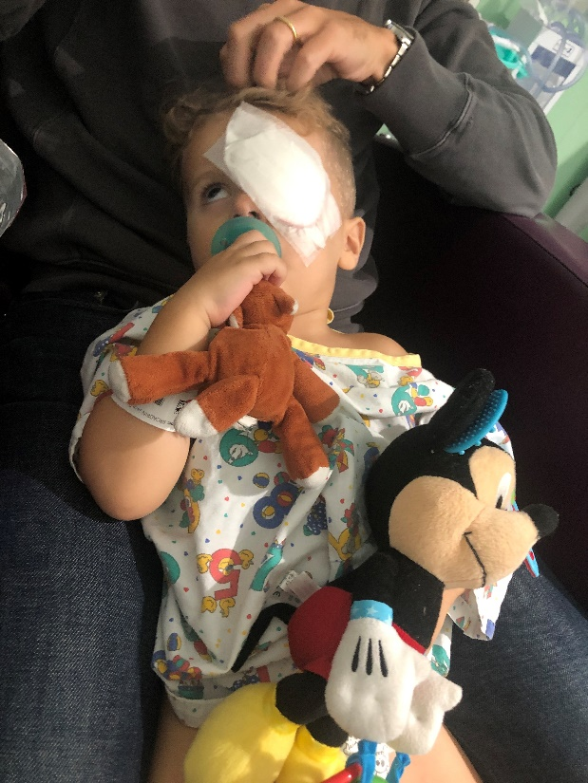
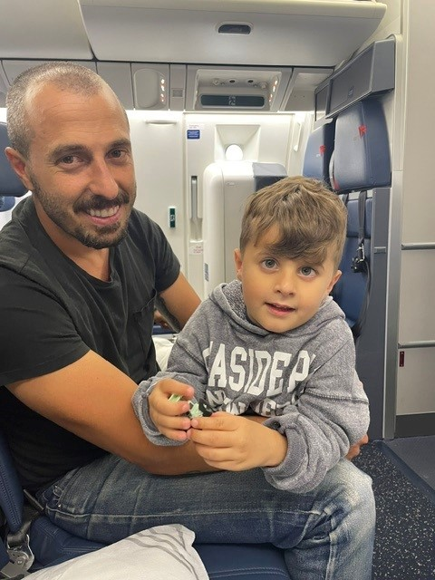
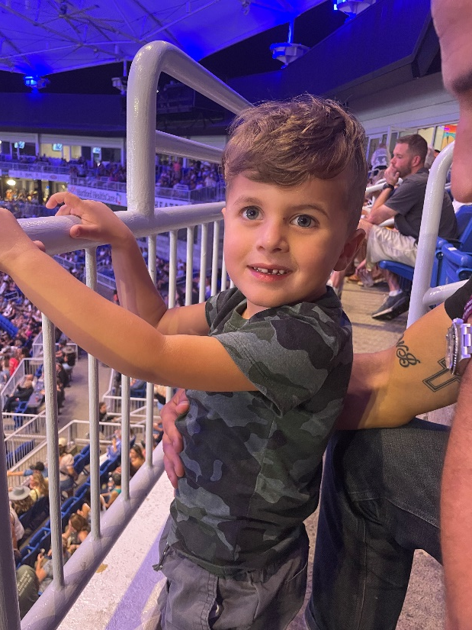
Research breakthroughs
Notes:
Our groundbreaking work on a gene therapy for LCA4 (Leber Congenital Amaurosis), a rare genetic eye condition that causes blindness from early childhood, saw remarkable results. All four children retained or improved the vision in the eye we treated. All four lost vision in the untreated eye.
Important work in artificial intelligence, or AI, showed the value of using the pigmentation in retinal scans as a determinant of ethnicity, rather than self-declared nationality.
Markers in the blood that predict whether glaucoma patients are at higher risk of continued loss of vision following conventional treatment have been identified in another study

Slide 20
Moorfields' research in numbers
Total number of studies – 159
Breakdown of studies – 43% commercial, 57% non-commercial
5071 research participants recruited
Total patients registered on ROAM – 3743
Notes:
During the year, we had a total of 159 live studies, of which 57% were non-commercial.
We recruited over 5,000 patients to participate in clinical trials.
We have developed ROAM as an online tool to support recruitment, and this now has 3,743 patients registered.

Slide 21
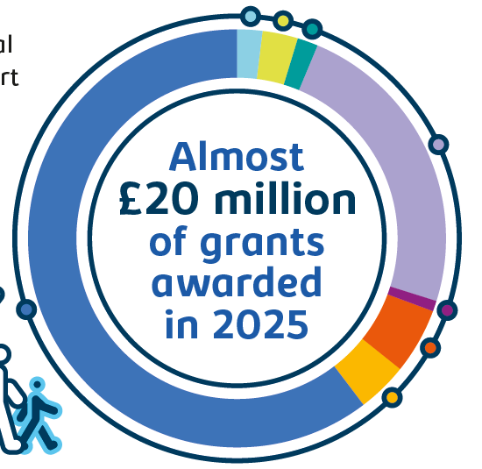
Moorfields Eye Charity’s impact
Investing in innovations, research, patient care, staff wellbeing and training
Changing lives of patients at Moorfields and elsewhere.
Notes:
In 2024/25, Moorfields Eye Charity awarded over 90 grants totalling almost £20 million.
Not only do the charity fund discovery research and cutting edge innovation, their support has led to improvements in patient experience and staff wellbeing. and has supported our ability to train and develop our staff.
Thank you to all the patients, carers and staff who made this possible – your support is making a real difference.

Slide 22
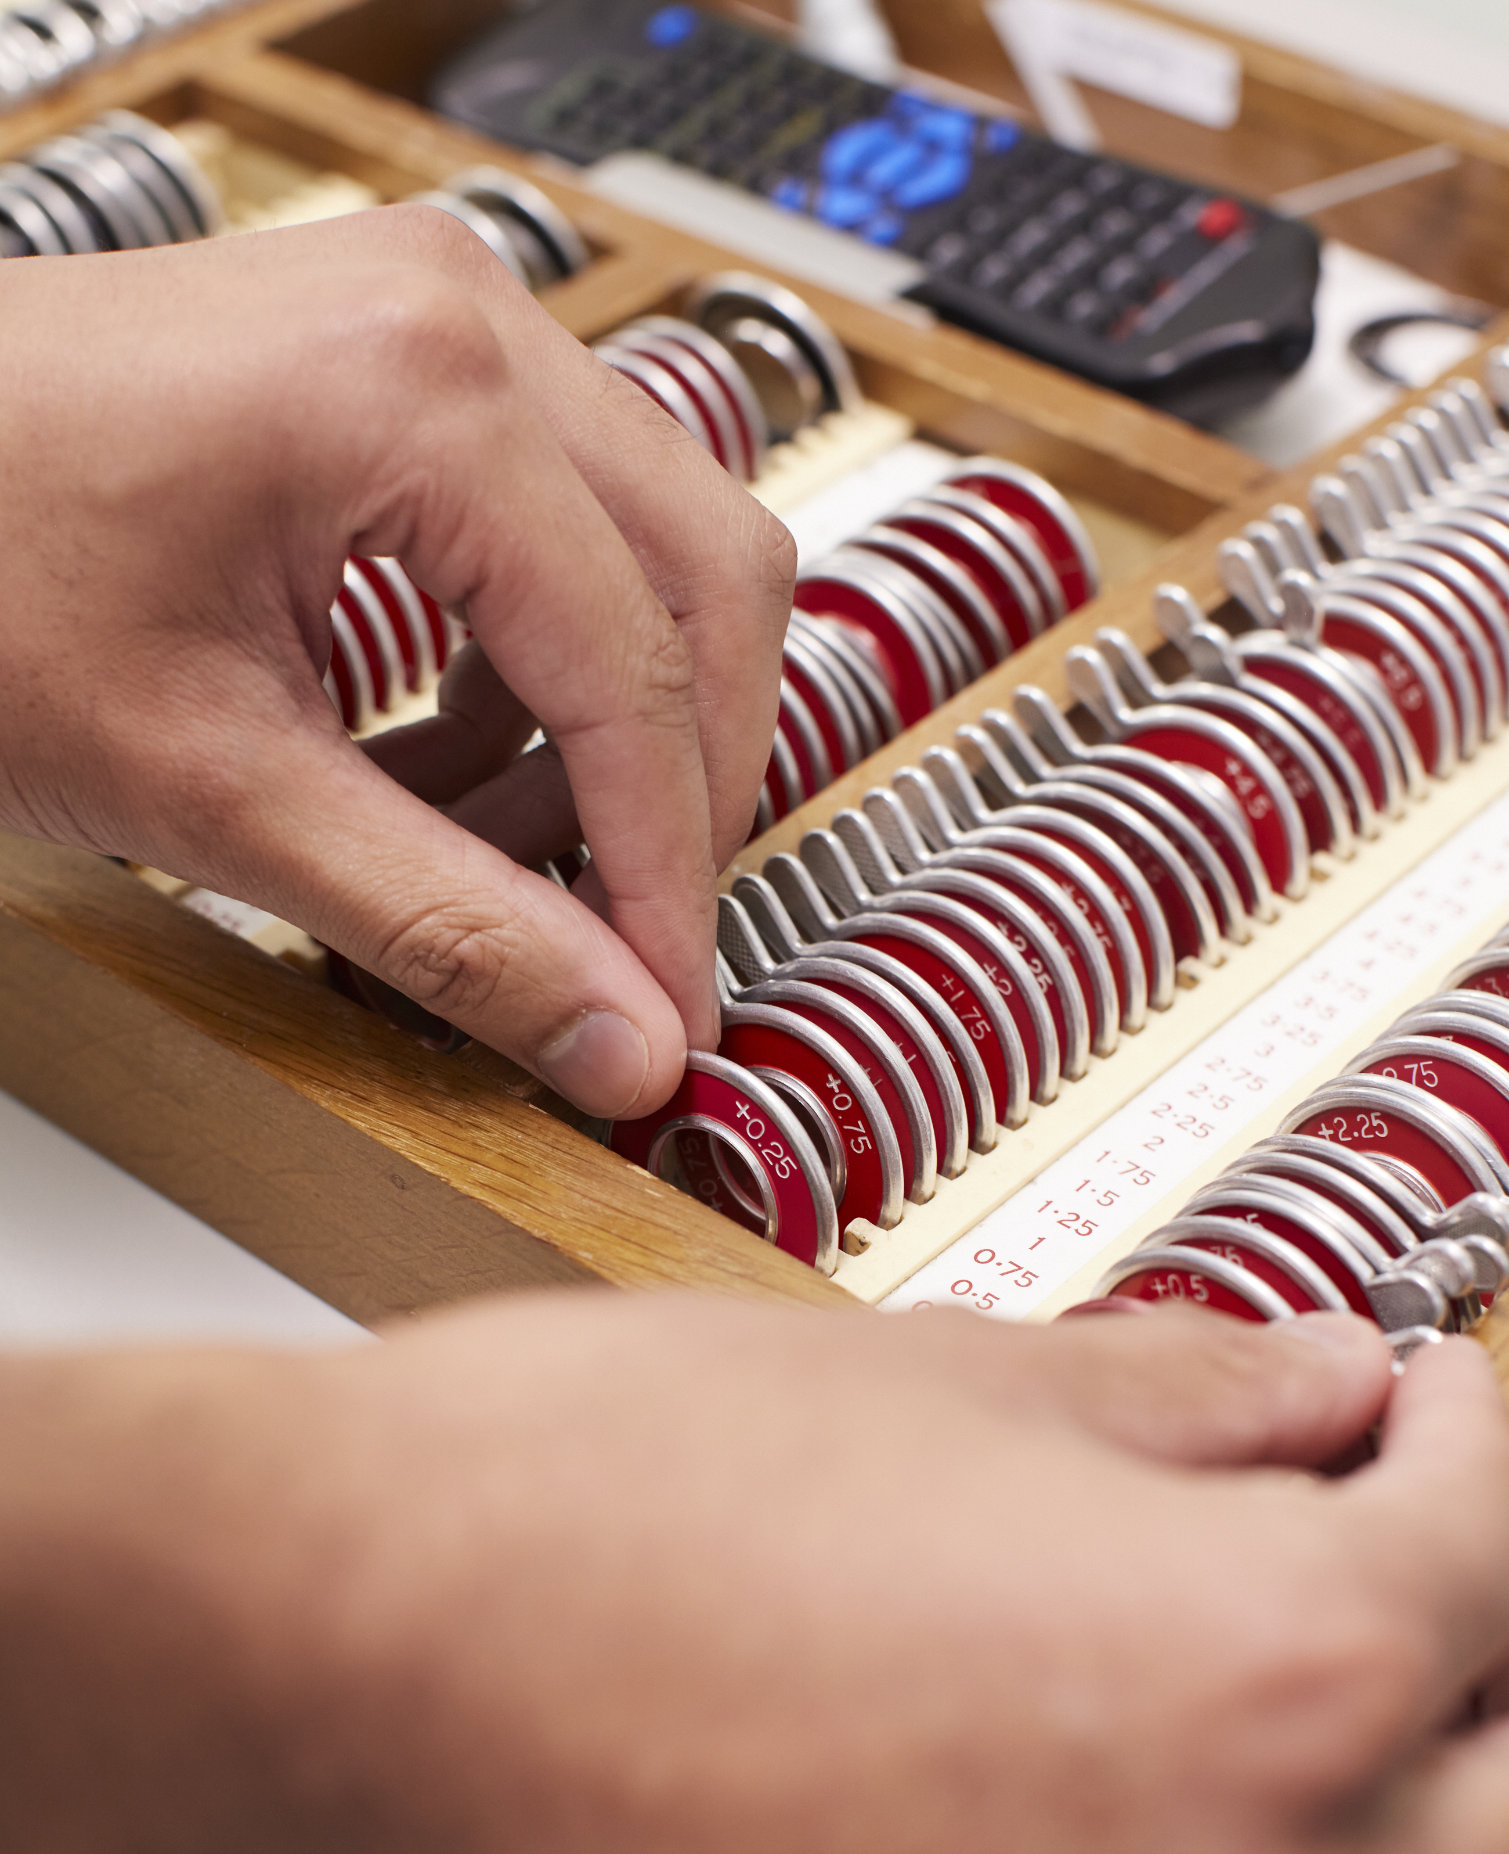
Develop
Notes:
Research is not the end in itself. We work hard to make sure our discoveries are made available for our patients, those across the NHS and beyond.
We also develop our clinical pathways, our physical and digital network and our operational systems, to make sure we continue to provide reliably excellent eye care

Slide 23
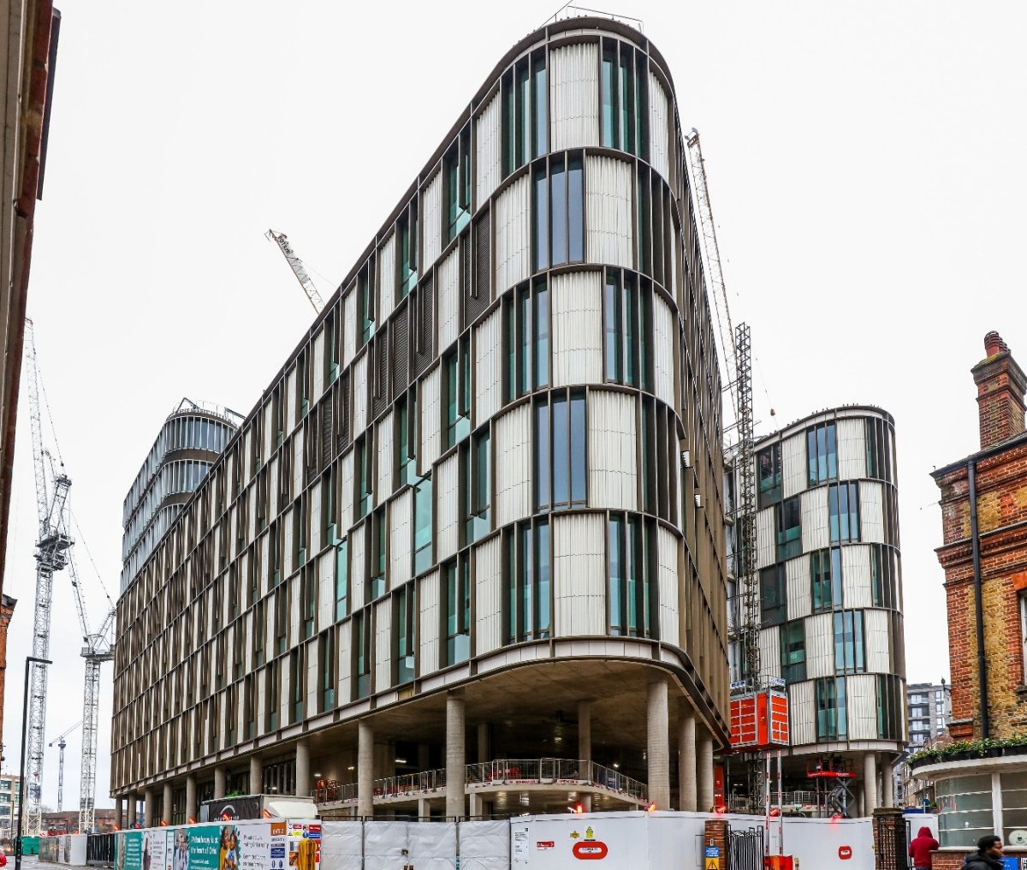
Oriel progress, 2024/25 development
Wayfinding – launched a transport survey for patients to input into the development of our wayfinding strategy. More than 500 patients responded to the survey.
Topping out – the building reached its maximum height in December 2024.
Interior design – Progressed work on our interior design plans.
Philanthropy - Received £1m from the Schroder Foundation and Family, and £1m from Friends of Moorfields.
Notes:
Wayfinding – we launched a transport survey for patients to input into the development of our wayfinding strategy. More than 500 patients responded to the survey.
Topping out – the building reached its maximum height in December 2024.
Interior design – We progressed work on our interior design plans.
Philanthropy - We received £1m from the Schroder Foundation and Family, and £1m from Friends of Moorfields.

Slide 24

MoorConnect electronic patient record (EPR)
Our electronic patient record programme made great strides in 2024/25.
Contract was signed with our EPR provider MEDITECH
Programme governance was established and a programme team created
MoorConnect, our programme identity was created and launched at our kindness in healthcare event on 4 December for all staff
During this year, the blueprint for our EPR was approaching completion which was a significant development
Notes:
It's been an exciting year with huge progress made in making our new EPR, MoorConnect, a reality. We signed the contract with our selected provider MEDITECH and we set about establishing the EPR team and the governance structure the programme will operate within.
Our programme identity, MoorConnect, was created and we were pleased to launch it at our all-staff kindness in healthcare event on 4 December. Work was also undertaken on our EPR blueprint.

Slide 25
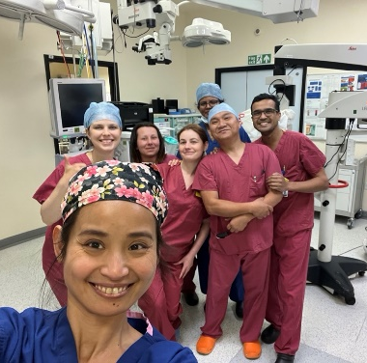
Deliver
Notes:
Discovering and developing are important, but delivering is crucial to our purpose, that 'People's sight matters'.
This section will cover financial and operational performance, as well as a couple of illustrations of the way we deliver our services, in line with our values of equity and kindness, as well as excellence.

Slide 26
Moorfields Private - UAE
Moorfields Dubai has been open for 18 years, seeing 385,000 patients and providing 32,000 surgeries in this period.
Moorfields Abu Dhabi has been open for 10 years, seeing 145,000 patients and providing 7,000 surgeries.
Notes:
Moorfields Dubai has been open for 18 years, during which it has seen over 385,000 patients and performed 32,000 surgeries.
Moorfields Abu Dhabi has been open for 10 years, seeing 145,000 patients and providing 7,000 surgeries.
Both branches are JCI-accredited, and in 2025, Moorfields Dubai became the first Eye hospital in the Middle East to achieve ACHSI Centre of Excellence accreditation.

Slide 27
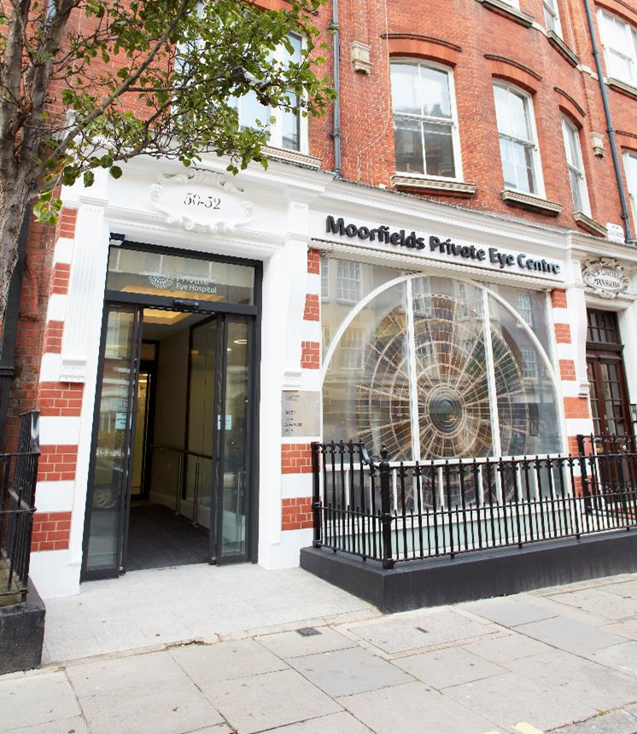
Moorfields Private
Moorfields Private is the fifth largest NHS private patient unit in the UK
In 2024/25, Moorfields Private fulfilled over 48k outpatient appointments, 5,400 surgeries and 1400 laser procedures
All the UK and UAE financial surplus from Moorfields Private is re-invested back into Moorfields for the benefit of all our patients.
Moorfields Private, New Cavendish Street
Notes:
Moorfields Private is the fifth largest NHS private patient unit in the UK, and in 2024/25 completed over 48k outpatient appointments, 5,400 surgeries and 1,400 laser procedures.
Moorfields Private invests time and resources in building relationships with optometrists, private GPs and International Health Offices to increase its referrals. Educational talks given by our consultants are a key element of this strategy. Our marketing team also creates further awareness of the services on offer to both referrers and patients. A success story for the last financial year is the running of refractive informational events for patients who are interested in vision correction. Led by our consultants, they have a 20-40% conversion to appointment rate.
All the UK and UAE financial surplus from Moorfields Private is reinvested back into Moorfields to benefit all our patients.

Slide 28

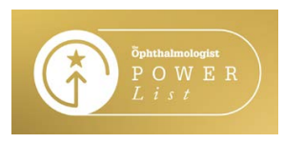
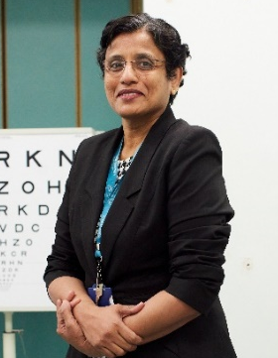
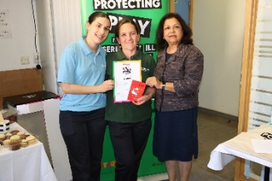
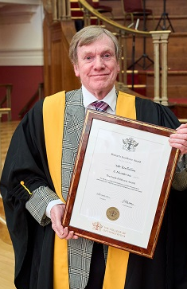
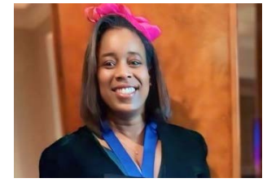
Recognition and leadership in ophthalmology
Ten on The Ophthalmologist’s Power List
Two further honours for Sobha Sivaprasad
Ken Pullum won College of Optometrists award
Flossie Donovan won a Starlight award
Dr Roxanne Crosby-Nwaobi was awarded a Fellowship by the Royal College of Nursing
Notes:
This year, ten of our clinicians were recognised in The Ophthalmologist’s Power List. This represented a staggering 20% of the people recognised worldwide in the shortened 2025 list.
Sobha Sivaprasad, one of the ten, was also honoured by the Macular Society and Asia-Pacific Vitreo-retinal Society.
Ken Pullum, principal optometrist, was awarded the Frank Petticrew Award for Contact Lens Research in Optometry by the College of Optometrists.
Flossie Donovan, play specialist, won charity Starlight’s Mentor of the Year 2024 award
Dr Roxanne Crosby Nwaobi, lead nurse for research, who has been awarded a Fellowship by the Royal College of Nursing (RCN).
There are many, many more honours I could mention, this just gives a flavour of the individual achievements across the spectrum of our staff.

Slide 29
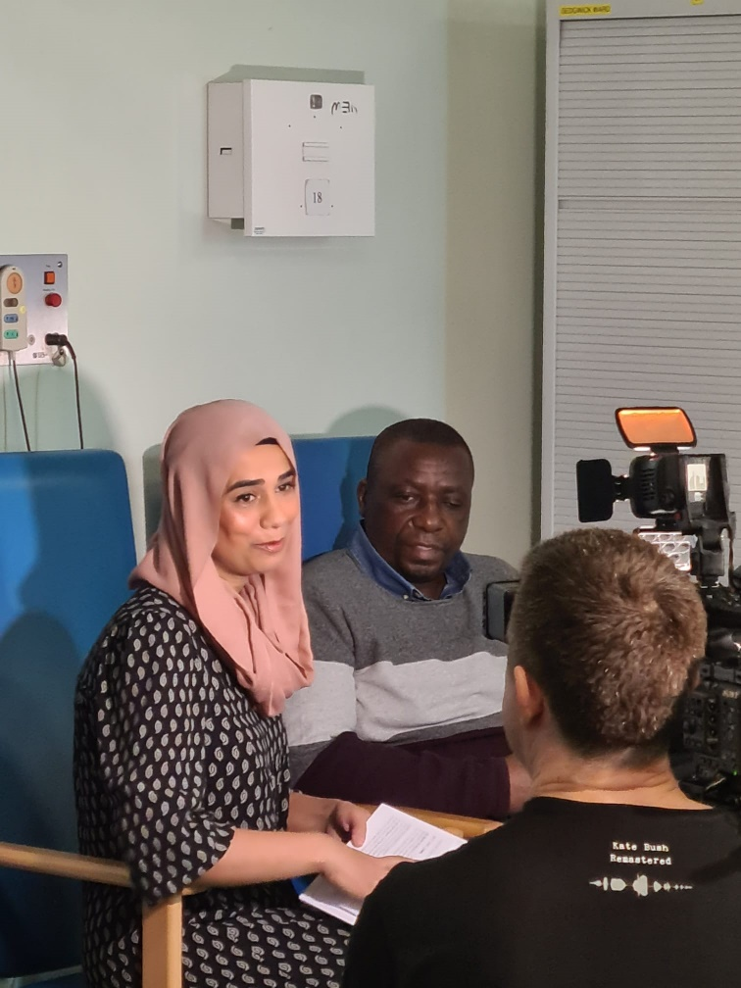
Media coverage
Top story – Gene therapy breakthrough for LCA4
Other TV coverage included ITV’s This Morning showcasing our cataract surgery, restoring a patient’s sight during the programme
Notes:
Our top media during the year was our biggest breakthrough, the gene therapy for LCA4
We welcomed Nighat Arif and ITV's This Morning to showcase our cataracts service, and they were able to film 'before and after' interviews with our surgeon Chris Leak and a patient who had lost his sight due to a rapid onset cataract. By the end of the programme, he could see again.
I would now like to hand over to Arthur Vaughan for a summary of our financial and operational performance.

Slide 30
Financial performance Arthur Vaughan– chief financial officer
Notes:
Thank you, Peter
The trust has shown growth in both NHS and Private income during 2024/25 through increased patient activity, with other operating income also increasing.
Other operating income includes research and development, education and training and charitable income.
The surplus reflects the phasing of payments for Oriel.
Cover off financial stability here
Now I am going to give you a review of our operational performance in 2024/25

Slide 31
Operational performance Arthur Vaughan – chief financial officer
Notes:
This year, we have seen further growth in our activities, by almost 5% against 2023/24, to over three quarters of a million appointments

Slide 32
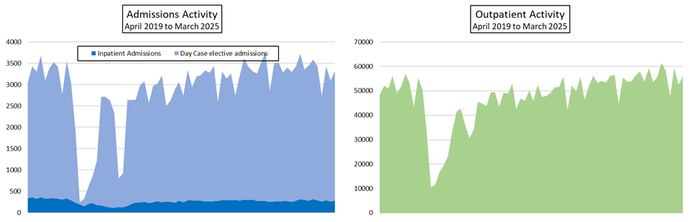
Performance now at pre-pandemic levels
Notes:
We have continued to consistently deliver both elective and outpatient activity at the same levels as before the pandemic

Slide 33
Performance – A&E and cancer targets
98% of A&E patients seen within 4 hours
All cancer targets met
83% of patients have been referred to treatment (RTT) within 18 weeks
Notes:
98% of patients are seen in A&E within four hours, the target being 95%
We also exceeded all six of the cancer targets
We are in the top 10 trusts nationally with our referral to treatment performance, a considerable improvement since the pandemic
Now I will be handing over to Sheila Adam our chief nurse who will be giving us a review of quality and safety, education and Friends of Moorfields

Slide 34
Quality and Safety improvements, 2024/25
Sheila Adam – chief nurse
Patient safety
We have implemented the patient safety incident response framework (PSIRF) to get the most learning from incidents, supporting patients and staff following an event and developing meaningful actions that lead to sustainable improvement.
Adopted shared decision-making, so all voices are heard
Clinical effectiveness
Performed well against the 28 national core clinical outcomes, including strong performances in cataract surgery, eye injections and retinal detachment
Patient experience
Improvements in patient transport and in Certificate of Vision Impairment processing times
Progress in implementing Accessible Information Standard
Wider quality work
Safer September – month of focused activities to reinforce that quality is central to all we do
Enabling continuous improvement across the Trust
Notes:
Thank you, Arthur,
We have implemented the patient safety incident response framework (PSIRF), which is a national framework and cultural shift that is focused on getting the most learning from incidents, supporting patients and staff following an event developing meaningful actions that lead to sustainable improvement.
For patient safety, we have:
Implemented the patient safety incident response framework (PSIRF), which is a national framework and cultural shift that is focused on getting the most learning from incidents, supporting patients and staff following an event and developing meaningful actions that lead to sustainable improvement.
We have also adopted shared decision-making, so all voices are heard in the process
For clinical effectiveness, we have:
Performed strongly against the 28 core clinical outcomes we are measured against nationally in the patient safety elements to reflect the patient safety incident response framework, also known as PSIRF.
We saw further reductions in our already-low complication rates for cataracts, showing further improvements in our post common surgical procedure.
We saw continued reductions in infection rates for those requiring regular eye injections, our most common procedure trust-wide.
We also continued our trend of increased success in retinal detachment surgery, with plans for nurse-led longer term follow-up to ensure that initial success rates are maintained.
For patient experience, we have:
Made improvements in patient transport and in Certificate of Vision Impairment processing times
Made progress in implementing the Accessible Information Standard across all our communications
And, in wider quality work, we have:
Celebrated Safer September, giving us a month of focused activities to reinforce that quality is central to all we do. This has included walkabouts, weekly focus areas, and targeted information gathering to drive future quality improvement across the Trust.
Worked hard to enable and promote continuous improvement across the Trust

Slide 35
Moorfields Education
It was a successful year for Moorfields Education.
In 2024-25 there were:
1,039 medical students and 44 physician associate students undertook short placements
There were 163 pre‑registration undergraduate student nurses and 16 apprentice nurses in training, with nine nurses registering with the NMC during the year
There were seven day, six four-week and five pre-registration orthoptic students and four pre-registration trainees in Optometry
Two trainee pharmacists and four trainee pharmacy technicians
OVS 3 and 4 imaging courses were delivered for ophthalmic technicians, and four healthcare scientist trainees were supported.
Notes:
It was a successful year for Moorfields Education, which offers education in Ophthalmology across a range of professions for undergraduates, post-graduates, apprenticeships and speciality short courses.
Read the figures out.
And then say:
Postgraduate education courses for non-medical staff are supported by CPD funds and income from some courses.
The Moorfields Academy provides an inclusive and multi‑professional forum for networking, scholarship, and topical education, it hosted three meetings with sixteen speakers on topics such as sexual misconduct in surgery, racial bias in ophthalmology, artificial intelligence, and art and wellbeing,

Slide 36
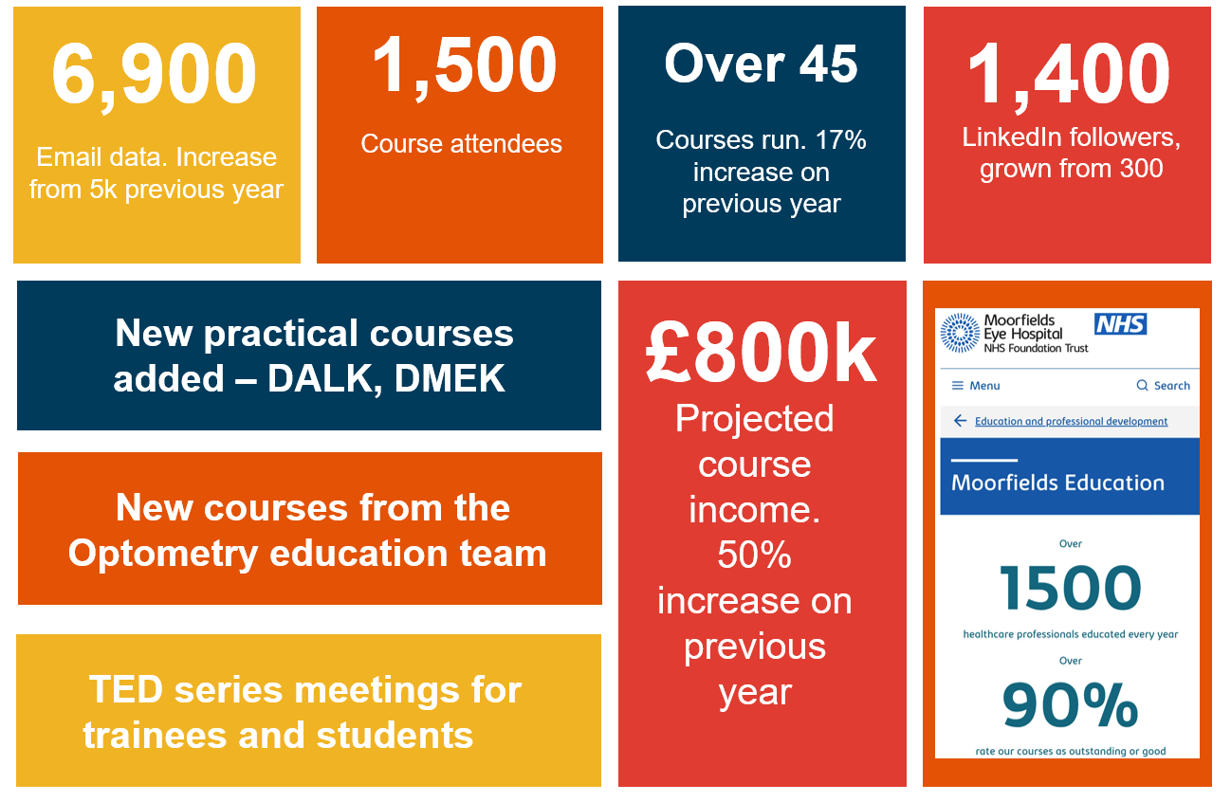

Moorfields commercial education
Notes:
It’s also been a strong year for Moorfields commercial education. They have achieved £800,000 in course income, which is an impressive 50% increase on previous year.
In a year, it has grown its LinkedIn following from 300 to 1,400.
There have been 1500 attendees at their courses.

Slide 37
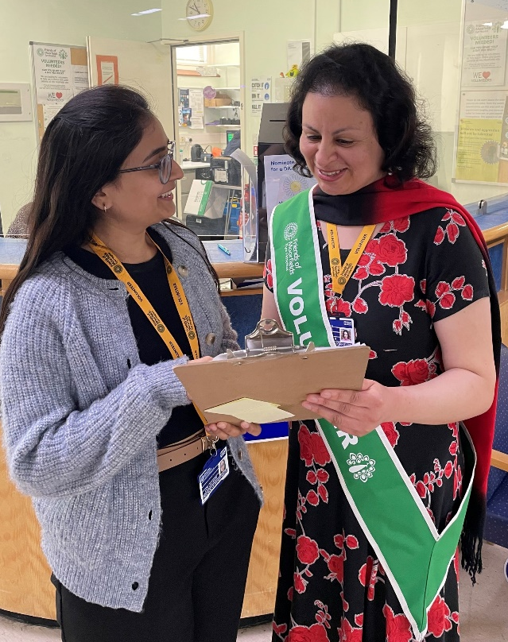

Friends of Moorfields
We currently have 327 active volunteers, providing the equivalent of 40 full-time staff posts, which would cost over £1million per year
Over the past year, our Health Information Hub at City Road handled around 4,000 enquiries
We were highly commended by the Charity Awards 2025 for Healthcare and Medical Research
Notes:
Friends of Moorfields currently have 327 active volunteers, providing 1,092 volunteer hours per week, plus another 242 potential volunteers going through the onboarding process.
In total our volunteers provide the equivalent of 40 full time staff posts. Even if they were paid at the lowest NHS ‘Agenda for Change’ pay band, their value would be around £1m.
Over the past year, the health information hub at City Road supported about 4,000 patient enquiries.
They were highly commended in the renowned Charity Awards 2025 for Healthcare and Medical Research.

Slide 38
What patients said
“I don’t know where I’d be in this very blurry world without Moorfields.”
“The impact Moorfields has had on my life cannot be overstated. They have saved the sight in both my right and left eyes.”
“From my time working in the NHS, I know what good looks like, and my experience was really stunning, excellent.”
“Your care has been life-changing for me. Thank you!”
Notes:
Thank you Sheila,
It is always great to end with some quotes from patients about their experience of being Moorfields patients so I thought I would read some out to you: Read the slide
And now I hand you back to Tim

Slide 39
Any questions?
Notes:
TIM TO CHAIR QUESTIONS
Thank you, Peter.
We asked for questions in advance, including from all those attending online, so we will answer those first before we take any questions from the hall.
QUESTIONS XXXX
Do we have any questions from the hall?
Thank you for such interesting questions.

Slide 40
Thank you for attending Moorfields Annual General Meeting The presentation and a recording of the meeting will be posted on www.moorfields.nhs.uk
Notes:
All that remains for me to say is thank you for being a part of this AGM, whether you're here in person or attending online
And I would like to remind you that the presentation and a recording of the AGM will be posted on the Moorfields website in the coming days

