Slide 1
Revolutionising Medical Implant Tracking
Team name: Visionaries
Made of surgeons, optometrists, doctors, orthoptists, coders and quality compliance officer

Slide 2
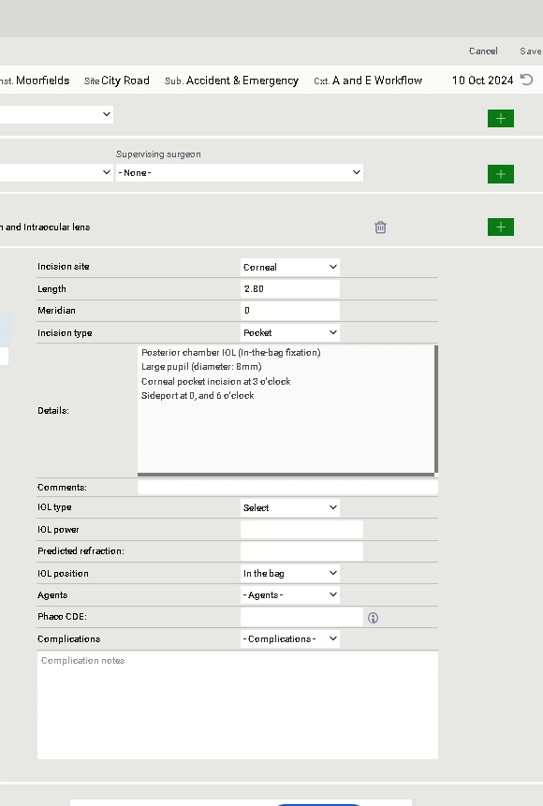

Background
At present we use a drop-down menu to select lens type and free-text to record power
Drop-down box includes over 200 lenses

Slide 3
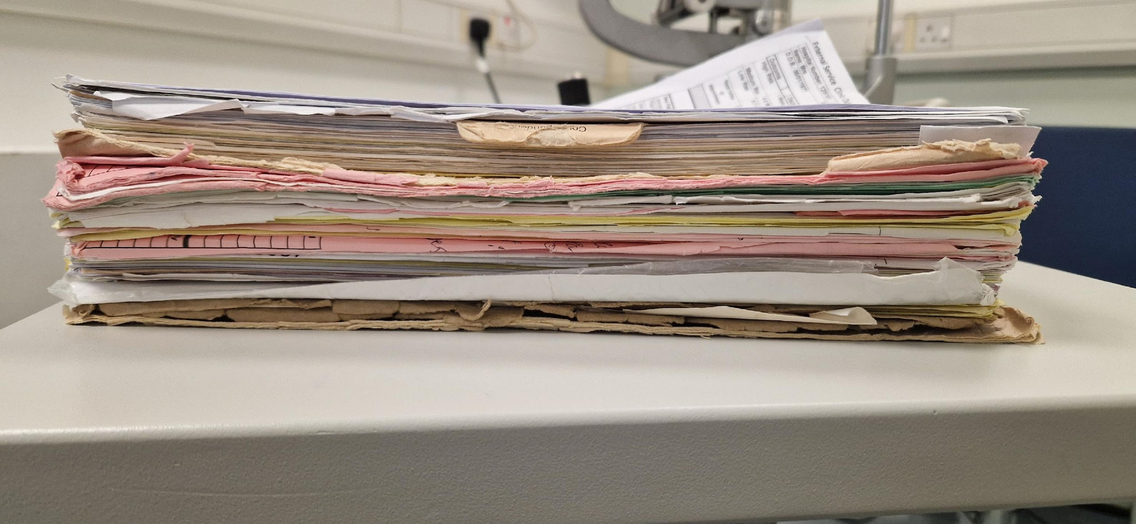
The Problem
No efficient electronic service exists to record batch numbers or expiry dates

Slide 4
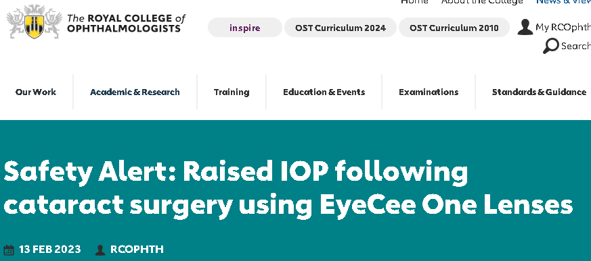
Impact analysis
In the past 10 years there have been THREE major high-profile IOL lens recalls
Affected surgeons had to sieve through countless paper notes to identify affected cases
*See appendix 1 & 2 for more details
Notes:
Recurring product issues have raised patient safety and quality control concerns, highlighting the need for stringent manufacturing and monitoring protocols.

Slide 5
Impact of Lens Recall
Patient
  Blindness
  Follow Up + Further Surgery
  More Medication
Clinical Team
  Time
  Clinic Time
NHS
  Increased cost for theatre time
  Reputational Damage
  Litigation cost

Slide 6
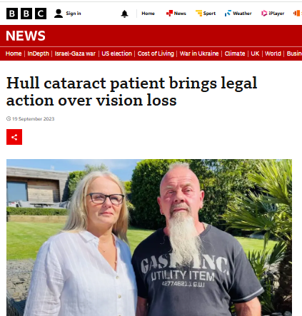

Slide 7
Process map: current state
Context: day of surgery
Open patient record
Check IOL type
Check IOL power
Input IOL type into patient record
Check IOL power input
Check IOL type input
Input IOL power into patient record
Confirm record

Slide 8
Process map: current state
Context: day of surgery
Open patient record
Check IOL type
Check IOL power
Input IOL type into patient record
Check IOL power input
Check IOL type input
Input IOL power into patient record
Key
Confirm record
Potential for human error
Total time taken = approx 4 mins per case

Slide 9

The Solution
Utilising Barcode Scanning Technology

Slide 10
Process map: proposed future state
Context: day of surgery
Open patient record
Confirm record
Scan IOL barcode
Time taken: approx 1 min
Notes:
1-step solution to current manual record keeping

Slide 11
1-Step Solution - Barcode Technology
A barcode is a machine-readable visual representation of data
Each IOL (intraocular lens) has a unique barcode that includes information such as:
  Batch number
  IOL power
  IOL type
  Expiration date

Slide 12
Live Demonstration

Slide 13
Benefit analysis (1/3)
Benefit category | Benefit breakdown
Traceability | Increased focus on medical device traceability Can identify batch related error earlier Cases easily searchable for recall investigation
Improved patient safety | Reduces risk of expired or incorrect IOLs

Slide 14
Benefit analysis (2/3)
Benefit category | Benefit breakdown
Improved efficiency and accuracy | Minimises manual entry errors Save time for surgical teams and more data captured (approx 30 mins per session = 1 extra case)
Scalable and cost-effective | Technology reproducible in other specialities User friendly integration with existing system

Slide 15
Benefit analysis (3/3)
Benefit category | Benefit breakdown
Audit and Research opportunities | Complete tracking of all IOL implants possible Access to more data for possible audits and research programmes
Vendor Benefits | Supply and Demand

Slide 16
Cost Analysis
Extra Cataract per list
14% Increase Efficiency
30 mins of theatre time = £750
400,000 Cases per year UK
Trust paid £500 per cataracts
Extra 56,000 cataracts a year ~ £28 Million
25 Million + Cases Annually around the world
Notes:
Rachel NHS Tariffs

Slide 17
Next steps
Liaise with relevant stakeholders
  Clinical staff, NHS trusts, EMR, Vendor and manufacturer
Pilot technology
Liaise with industry
Notes:
OpenEyes team to incorporate barcode scanning technology

Slide 18
It’s not just a barcode, it could save your sight!
Thank you
Any Questions?

Slide 19
Appendices

Slide 20
Appendix 1:
Summary of significant intraocular lens (IOL) recalls in the UK since 2017:
Year | Manufacturer | Product | Issue | Notes
2017 | Oculentis GmbH | Oculentis IOLs (2012-2015 batch) | Lens surface calcification leading to reduced visual acuity due to a phosphate cleaning agent | Affected lenses manufactured between Jan 2012 and May 2015 were recalled globally​.
2019 | Oculentis GmbH | Oculentis LS-313 and related models | Post-implant opacification issues due to calcification. | About 800 patients in the UK were potentially affected. Replacement lenses were provided
2023 | NIDEK | EyeCee One and EyeCee One Crystal preloaded IOLs | Increased intraocular pressure linked to a manufacturing problem affecting lenses from Sept 2021 to Nov 2022. | Affected lenses were quarantined; patients monitored for elevated pressure
Notes:
PSIRF NHS England » Patient Safety Incident Response Framework
Patient Safety Event

Slide 21
Appendix 2: Case example
EyeCee One IOLs manufactured between Sep 2021 and Nov 2022 had a manufacturing problem with coating of lens
  This was picked up in February 2023
2-6% of patients had raised IOP
  Patients required early follow ups, additional drops, IOL exchanges and tube surgery
Affected local hospitals
  Affected surgeons had to sieve through countless notes to identify affected cases

Slide 22
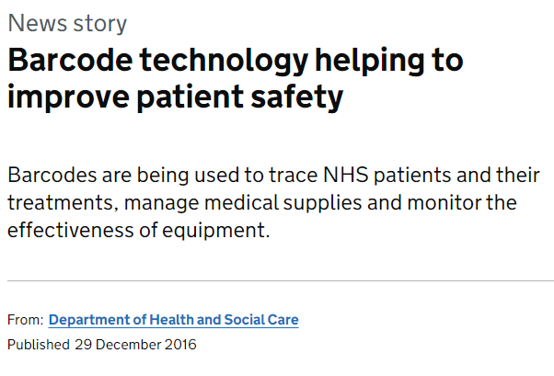

Slide 23
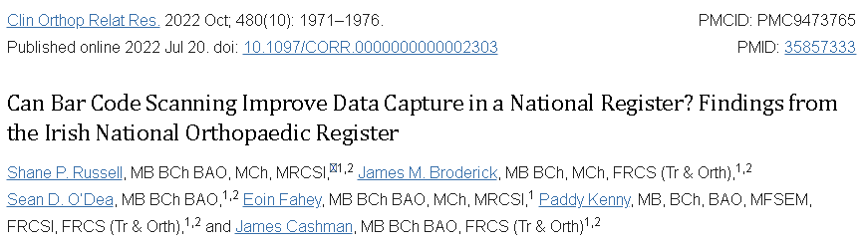
Retrospective review with research Question of;
  Does bar code scanning improve the completeness of implant records?
  Does bar code scanning improve the accuracy of implant records?
Results
  “Proportion of missing data declined from 7% (135 of 2051) to 0% (0 of 2193)
  Proportion of incorrectly recorded implant parameters declined from 2% (45 of 2051) to 0% (0 of 2193).
  Proportion of procedures with entirely accurate implant records rose from 53% (133 of 250) to 100% (250 of 250).”
Notes:
Single centre retrospective review of pre and post implementation of barcode technology

Slide 24
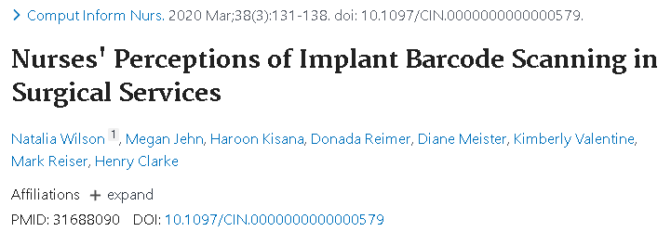
Survey of nurses
Degree of acceptability among nurses in the use of this technology
Should be involved in implementation process with benefits of technology highlighted
Notes:
Survey

Slide 25
Incorporating barcode scanning technology
Embedding of barcode scanning technology into current electronic medical records (EMR)
Appropriate parameters to be extracted from scanned barcode onto EMR
Alert function incorporated into EMR for expiry dates and incorrect lenses selected
Appropriate API for linking hardware software with EMR
Purchasing hardware to scan bar codes

Slide 26
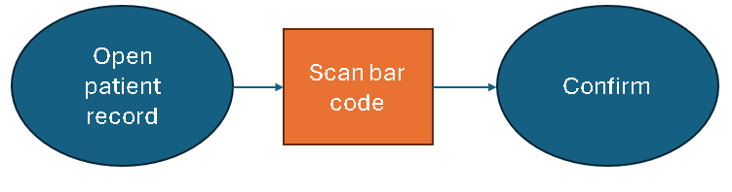
Process flow map – Proposed model

Slide 27
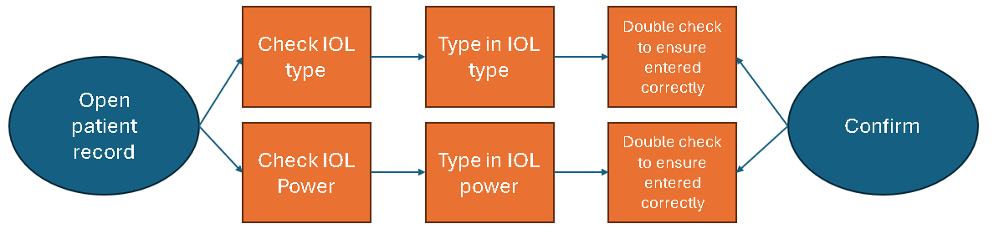
Process flow map – Current method

Slide 28
Benefits
Improved patient safety
  Reduces likelihood of expired or incorrect IOL
  Minimizes manual entry errors
Enhanced traceability
  Complete tracking of all implanted IOLs possible
  Aiding in recalls or audits
  May be able to pick up issues to relating to particular batches or lenses
More time efficient with more data points extracted
Technology reproducible in others (sub)specialties
Access to large data & future research
  IOP rises, Lens exchanges, Dysphotopsias, Many more

Slide 29
Patient experience
Blindness
Anxiety
Additional follow ups
Glaucoma surgery
IOL exchanges
Additional drops
Notes:
Increased patient blindness
Increased patient anxiety
Additional follow ups,
Additional drops,
IOL exchanges,
Tube surgery

Slide 30
Why is this important
Inefficient documentation processes lead to compliance and recall challenges.
Manual data entry increases the risk of errors.

Slide 32
The risks
Human error
  Selecting the incorrect IOL type
  Typing the incorrect IOL power
Inserting incorrect / expired IOL implants
IOL batches cannot be tracked unless sieving through paper notes which can be laboursome and difficult if notes are lost

Slide 33
The problem
Inability to trail audit and track patient intraocular lens batches

Slide 34
Outline
Background
Issue
Impact analysis
Patient experience
Barcode technology
Process map
Live demonstration
Benefit analysis
Next steps
Appendix

Slide 35
Manufacturer benefits
Improved traceability with aid in recall in case of errors
  May be able to pick up faults quicker
Will aid in investigations
Able to assist in auditing inventory – Supply / demand
Metrics on outcomes (ie satisfaction, complications etc)

