Slide 1
Triage AI
Moorfields Hackday ‘24

Slide 2
Needs statement
Triage AI
How might we read GP referral letters and automate non-emergency eye-triaging in order to allocate resources more efficiently

Slide 3
Problem

Slide 4




Triage AI

Slide 5
Triage AI
19 M
165 K
~2000 days
NHS England, Total referrals
London Ophthalmology
(2023-2024)
(2023-2024)
https://digital.nhs.uk/dashboards/ers-open-data
Notes:
Total number of referrals that are generated across NHS in England in 1 year (2023-2024): 19, 173, 896
Total number of referrals that are generated within London for Ophthalmology in 1 year (2023-2024): 165, 643
Number of minutes spent by senior doctors on referrals: 828, 215
Number of hours spent: 13, 804
Total number of working days: 1, 972 (6 doctors full time for 1 year)

Slide 6
Technical overview

Slide 7
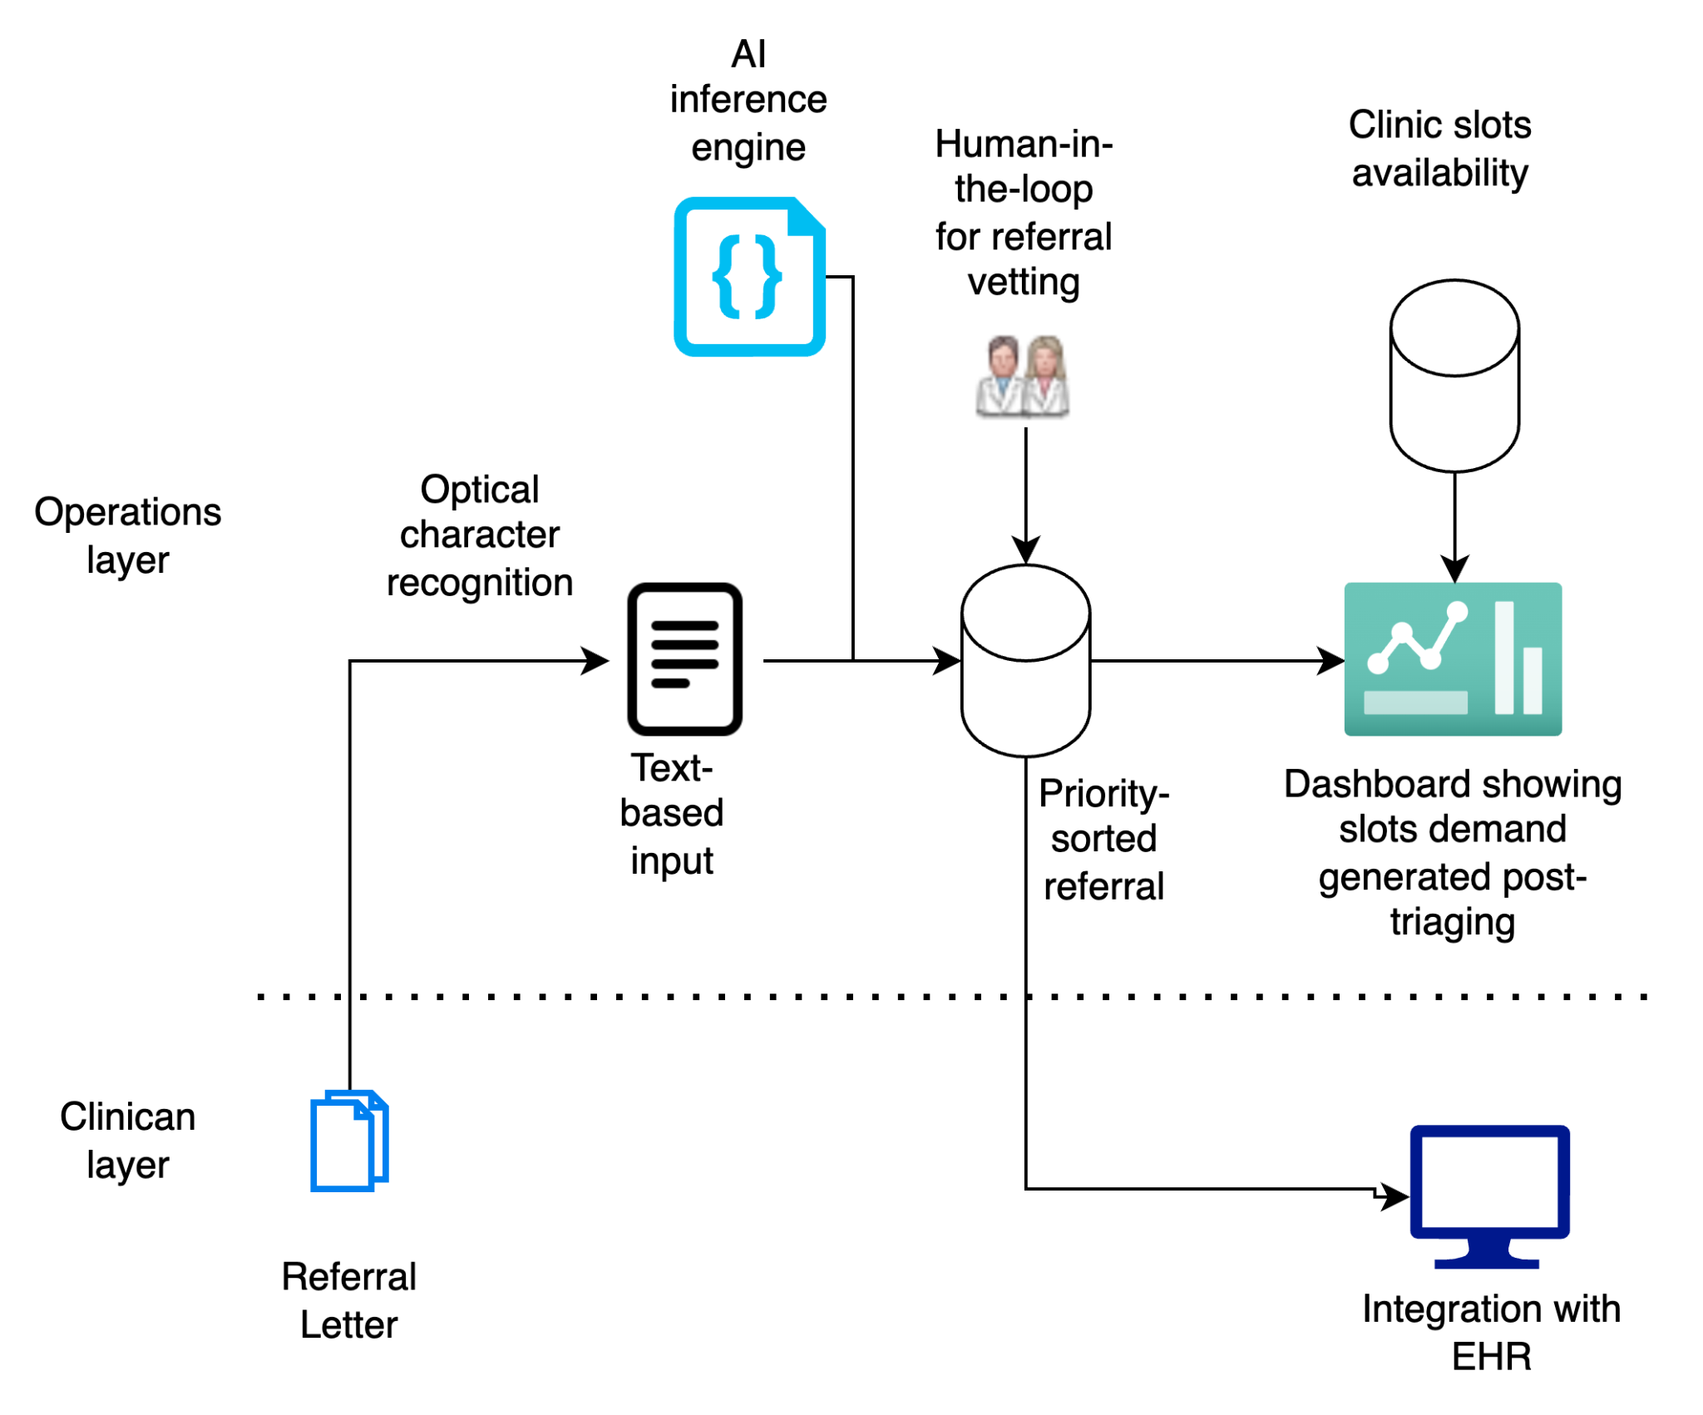

Slide 8
Prototype

Slide 9
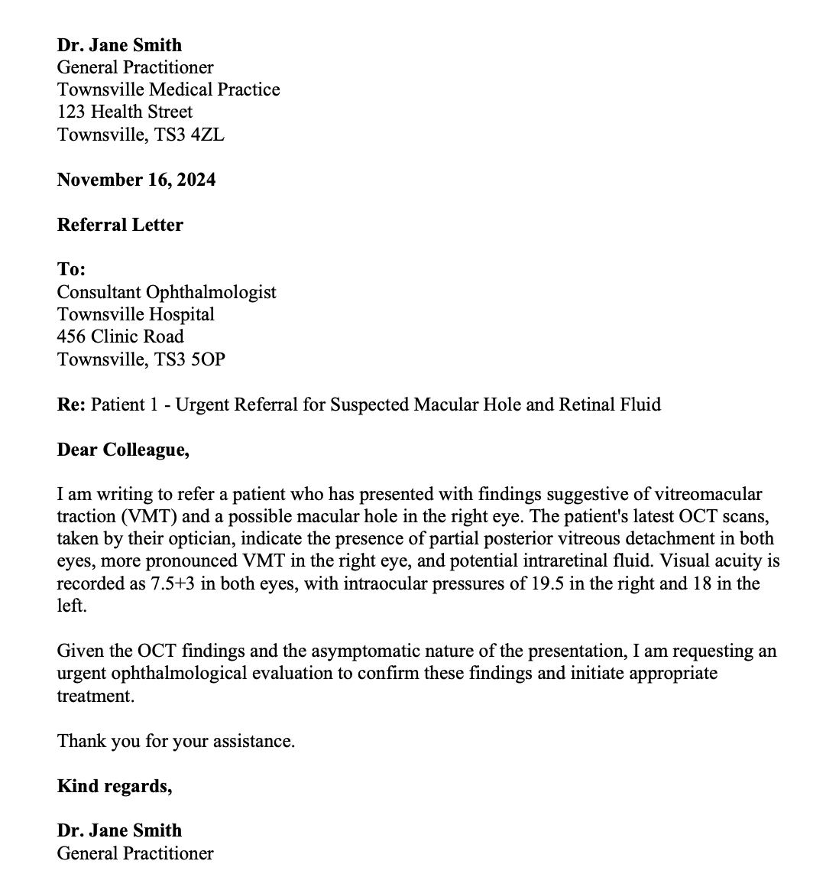
Triage AI

Slide 10

Triage AI

Slide 11
Free up Senior Doctors
Tertiary Care
1
Notes:
Ophthalmology:
Nationally:

Slide 12
Risk Stratification
Tertiary Care
2
Notes:
Safety

Slide 13
Up to date wait lists (Real-time)
Management
3

Slide 14
Instant GP Feedback
Primary Care
4

Slide 15
Clinic Usage Case
Clinical practice
5

Slide 16
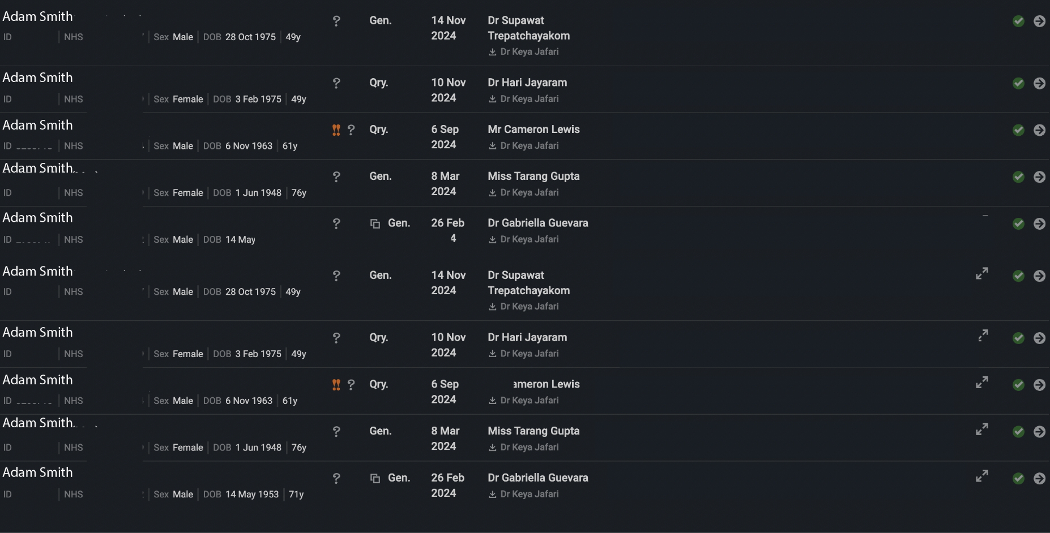
Notes:
Example of how you can order by priority, you have the presenting complaint + urgency

Slide 17
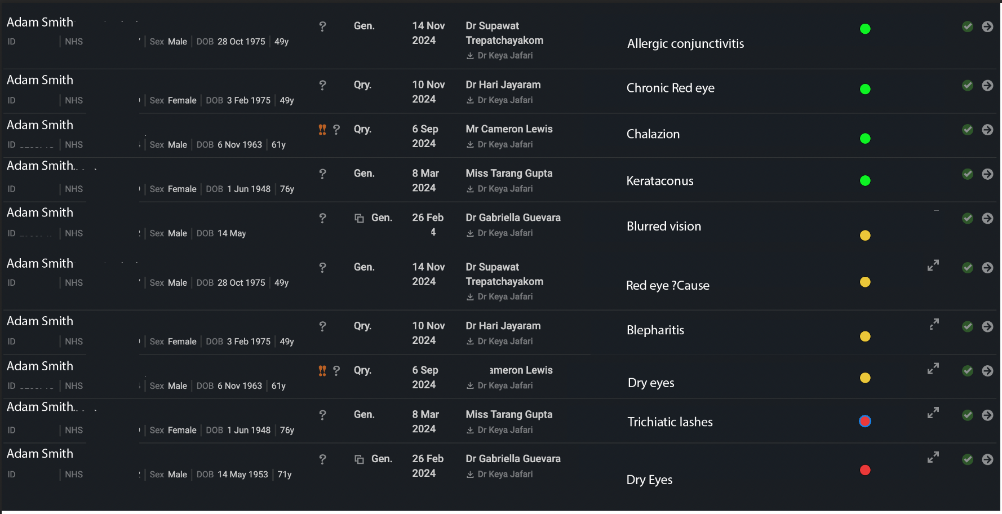

Slide 18
Next steps

Slide 19
Triage AI
Improve model’s performance
Test using other LLMs
Clinical validation test (Ophthalmology is ideal)
Run a parallel model with current triaging system
Proof-of-value
Calculate manpower savings
User study
Software architecture design
Integration into current electronic records

Slide 20

Time.
For what matters.

Slide 21
Questions?

Slide 22
Triage AI
Trial alongside current consultant triage
Compare outputs
Train the model further using existing processes
Implement in a low risk speciality
Pearls of Ophthalmology
Oriel

